Slide 1
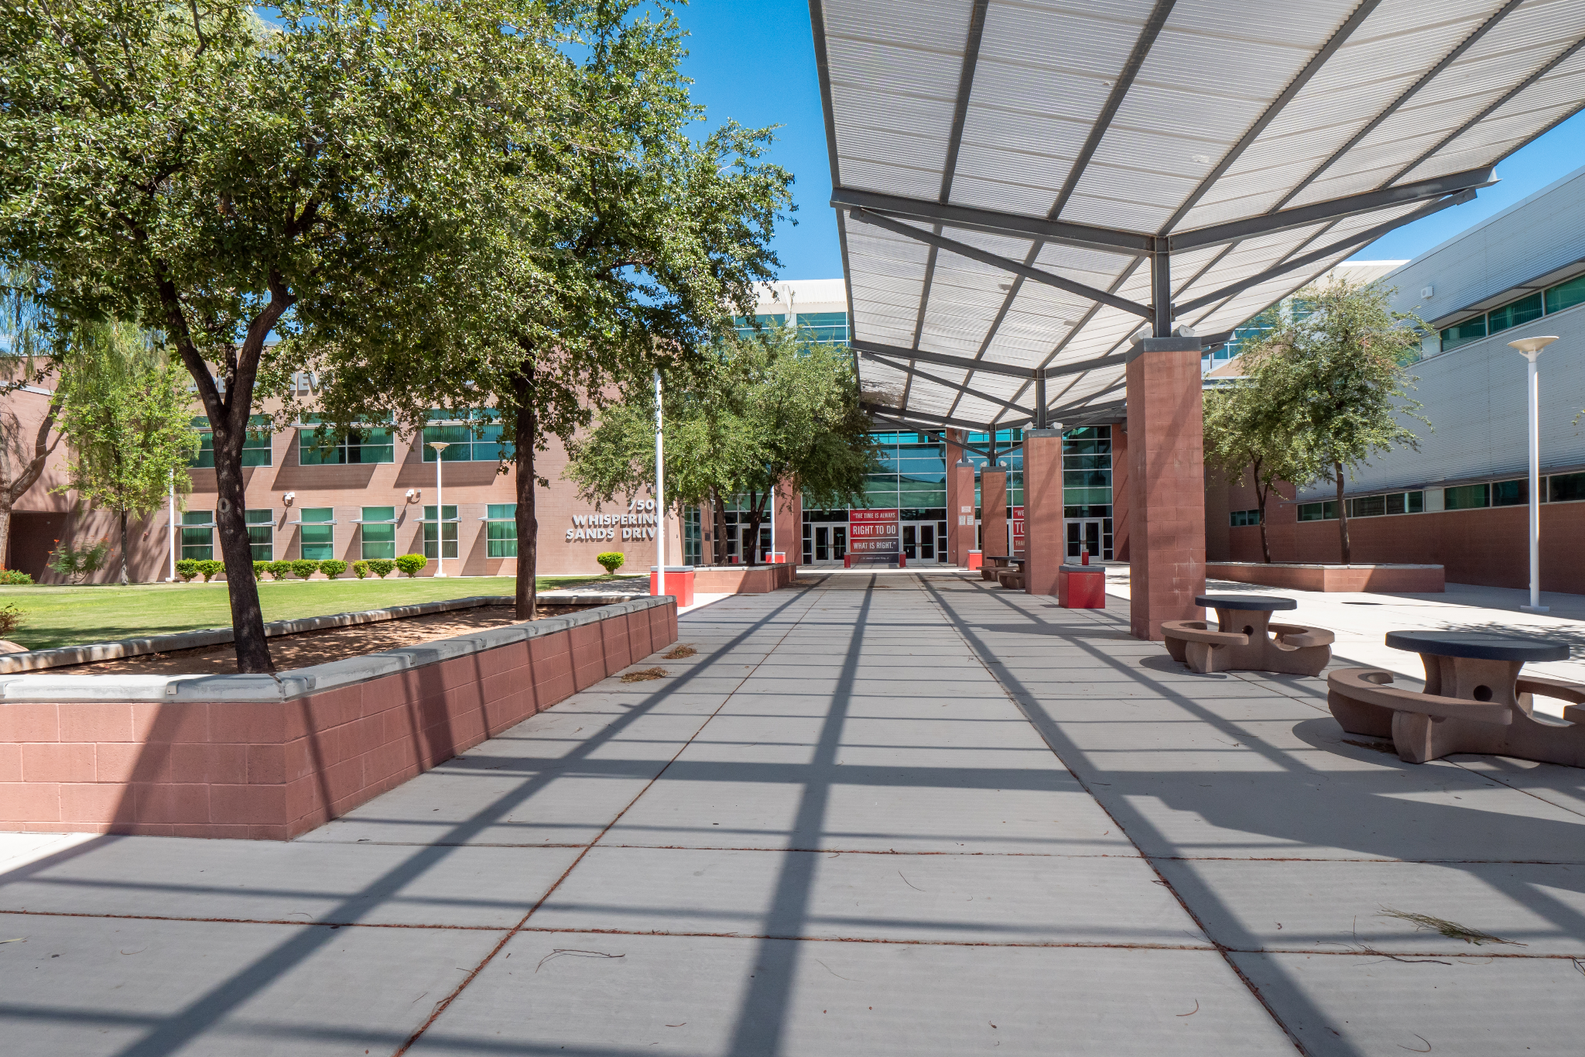
89131A Menu
89131A
MECHANICAL BULLS
AUTON
Arbor View High School
MOTORS
CONTROLLER
Kenzy
SETTINGS

Slide 2
89131A Menu
89131A
MECHANICAL BULLS
AUTON
Arbor View High School
MOTORS
CONTROLLER
Shyloh
SETTINGS

Slide 3
89131A Menu
Theme
Background:
Color:
AV HS
AV HS
Other
Other
Other
Other
Other
Other
Other
Other
SETTINGS

Slide 4
89131A Menu
Theme
Background:
Color:
AV HS
AV HS
Other
Other
Other
Other
Other
Other
Other
Other
SETTINGS

Slide 5
89131A Menu
Motors
Drivetrain
Lift
Roller
L1
Ready
R1
Ready
L1
Ready
R1
Ready
2B
Ready
R
Ready
L2
Ready
R2
Warm
L3
Ready
R3
Over
MOTORS

Slide 6
89131A Menu
Motors
Drivetrain
Lift
Roller
L1
Ready
R1
Ready
L1
Ready
R1
Ready
2B
Ready
R
Ready
L2
Ready
R2
Warm
L3
Ready
R3
Over
MOTORS

Slide 7
89131A Menu
Alliance
Skills
AUTON

Slide 8
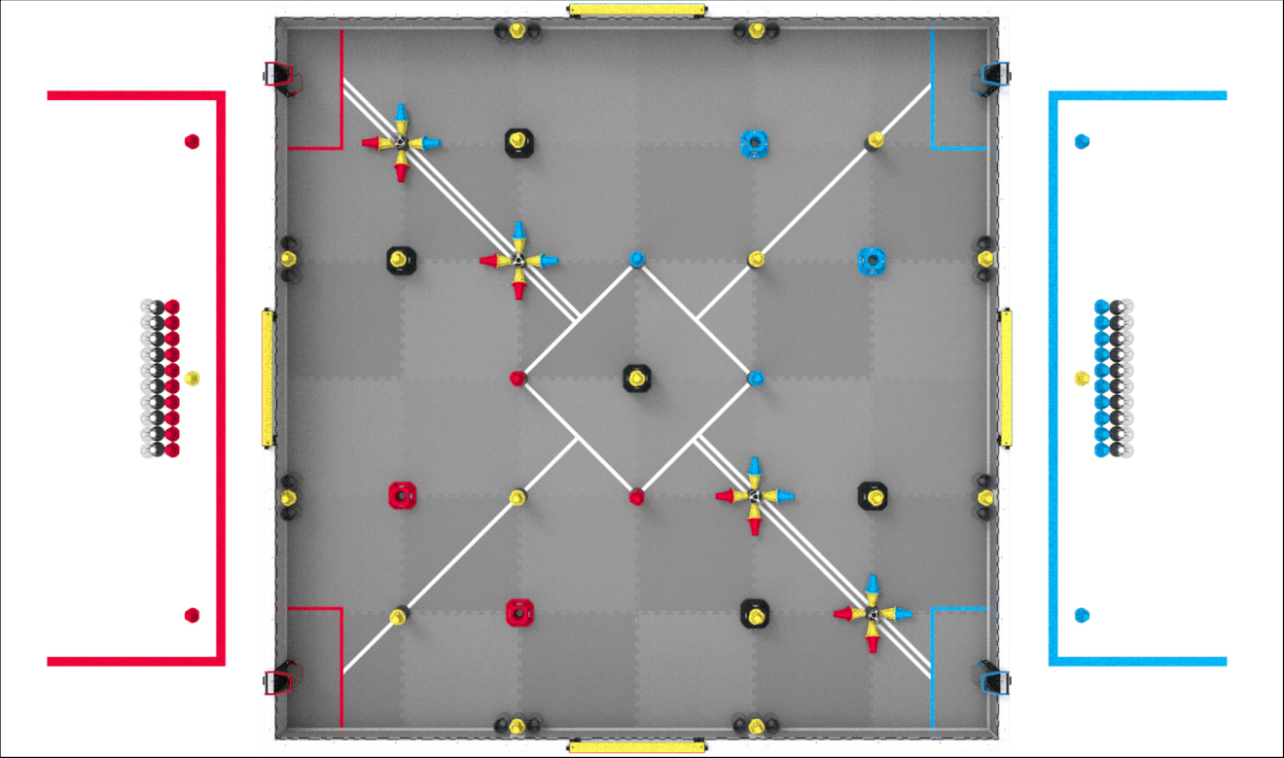
89131A Menu
Alliance
Quadrant 1
Quadrant 2
AWP
BACK

Slide 9
89131A Menu
Alliance
Quadrant 1
Quadrant 2
AWP
BACK

Slide 10
89131A Menu
Alliance
Quadrant 1
Quadrant 2
AWP
BACK

Slide 11
89131A Menu
Alliance
Quadrant 1
Quadrant 2
AWP
BACK

Slide 12
89131A Menu
Alliance
Quadrant 1
Quadrant 2
AWP
BACK

Slide 13
89131A Menu
Alliance
Quadrant 1
Quadrant 2
AWP
BACK

Slide 14
89131A Menu
Skills
SELECT

Slide 15
89131A Menu
Skills Selected
CONTROLLER
Shyloh
CHECK
MOTORS
BACK

Slide 16
89131A Menu
Red Quadrant 1 Selected
CONTROLLER
Shyloh
CHECK
MOTORS
BACK

Slide 17
89131A Menu
Red Quadrant 2 Selected
CONTROLLER
Shyloh
CHECK
MOTORS
BACK

Slide 18
89131A Menu
Red AWP Selected
CONTROLLER
Shyloh
CHECK
MOTORS
BACK

Slide 19
89131A Menu
Motors
Drivetrain
Lift
Roller
L1
Ready
R1
Ready
L1
Ready
R1
Ready
2B
Ready
R
Ready
L2
Ready
R2
Ready
L3
Ready
R3
Ready
BACK

Slide 20
89131A Menu
Motors
Drivetrain
Lift
Roller
L1
Ready
R1
Ready
L1
Ready
R1
Ready
2B
Ready
R
Ready
L2
Ready
R2
Ready
L3
Ready
R3
Ready
BACK

Slide 21
89131A Menu
Motors
Drivetrain
Lift
Roller
L1
Ready
R1
Ready
L1
Ready
R1
Ready
2B
Ready
R
Ready
L2
Ready
R2
Ready
L3
Ready
R3
Ready
BACK

Slide 22
89131A Menu
Motors
Drivetrain
Lift
Roller
L1
Ready
R1
Ready
L1
Ready
R1
Ready
2B
Ready
R
Ready
L2
Ready
R2
Ready
L3
Ready
R3
Ready
BACK

Slide 23
89131A Menu
Blue Quadrant 1 Selected
CONTROLLER
Shyloh
CHECK
MOTORS
BACK

Slide 24
89131A Menu
Blue Quadrant 2 Selected
CONTROLLER
Shyloh
CHECK
MOTORS
BACK

Slide 25
89131A Menu
Blue AWP Selected
CONTROLLER
Shyloh
CHECK
MOTORS
BACK

Slide 26
89131A Menu
Motors
Drivetrain
Lift
Roller
L1
Ready
R1
Ready
L1
Ready
R1
Ready
2B
Ready
R
Ready
L2
Ready
R2
Ready
L3
Ready
R3
Ready
BACK

Slide 27
89131A Menu
Motors
Drivetrain
Lift
Roller
L1
Ready
R1
Ready
L1
Ready
R1
Ready
2B
Ready
R
Ready
L2
Ready
R2
Ready
L3
Ready
R3
Ready
BACK

Slide 28
89131A Menu
Motors
Drivetrain
Lift
Roller
L1
Ready
R1
Ready
L1
Ready
R1
Ready
2B
Ready
R
Ready
L2
Ready
R2
Ready
L3
Ready
R3
Ready
BACK

Slide 29
89131A Menu
Alliance
Skills
AUTON

Slide 30
89131A Menu
Alliance
Quadrant 1
Quadrant 2
AWP
BACK

Slide 31
89131A Menu
Alliance
Quadrant 1
Quadrant 2
AWP
BACK

Slide 32
89131A Menu
Alliance
Quadrant 1
Quadrant 2
AWP
BACK

Slide 33
89131A Menu
Alliance
Quadrant 1
Quadrant 2
AWP
BACK

Slide 34
89131A Menu
Alliance
Quadrant 1
Quadrant 2
AWP
BACK

Slide 35
89131A Menu
Alliance
Quadrant 1
Quadrant 2
AWP
BACK

Slide 36
89131A Menu
Skills
SELECT

Slide 37
89131A Menu
Skills Selected
CONTROLLER
Kenzy
CHECK
MOTORS
BACK

Slide 38
89131A Menu
Red Quadrant 1 Selected
CONTROLLER
Kenzy
CHECK
MOTORS
BACK

Slide 39
89131A Menu
Red Quadrant 2 Selected
CONTROLLER
Kenzy
CHECK
MOTORS
BACK

Slide 40
89131A Menu
Red AWP Selected
CONTROLLER
Kenzy
CHECK
MOTORS
BACK

Slide 41
89131A Menu
Motors
Drivetrain
Lift
Roller
L1
Ready
R1
Ready
L1
Ready
R1
Ready
2B
Ready
R
Ready
L2
Ready
R2
Ready
L3
Ready
R3
Ready
BACK

Slide 42
89131A Menu
Motors
Drivetrain
Lift
Roller
L1
Ready
R1
Ready
L1
Ready
R1
Ready
2B
Ready
R
Ready
L2
Ready
R2
Ready
L3
Ready
R3
Ready
BACK

Slide 43
89131A Menu
Motors
Drivetrain
Lift
Roller
L1
Ready
R1
Ready
L1
Ready
R1
Ready
2B
Ready
R
Ready
L2
Ready
R2
Ready
L3
Ready
R3
Ready
BACK

Slide 44
89131A Menu
Motors
Drivetrain
Lift
Roller
L1
Ready
R1
Ready
L1
Ready
R1
Ready
2B
Ready
R
Ready
L2
Ready
R2
Ready
L3
Ready
R3
Ready
BACK

Slide 45
89131A Menu
Blue Quadrant 1 Selected
CONTROLLER
Kenzy
CHECK
MOTORS
BACK

Slide 46
89131A Menu
Blue Quadrant 2 Selected
CONTROLLER
Kenzy
CHECK
MOTORS
BACK

Slide 47
89131A Menu
Blue AWP Selected
CONTROLLER
Kenzy
CHECK
MOTORS
BACK

Slide 48
89131A Menu
Motors
Drivetrain
Lift
Roller
L1
Ready
R1
Ready
L1
Ready
R1
Ready
2B
Ready
R
Ready
L2
Ready
R2
Ready
L3
Ready
R3
Ready
BACK

Slide 49
89131A Menu
Motors
Drivetrain
Lift
Roller
L1
Ready
R1
Ready
L1
Ready
R1
Ready
2B
Ready
R
Ready
L2
Ready
R2
Ready
L3
Ready
R3
Ready
BACK

Slide 50
89131A Menu
Motors
Drivetrain
Lift
Roller
L1
Ready
R1
Ready
L1
Ready
R1
Ready
2B
Ready
R
Ready
L2
Ready
R2
Ready
L3
Ready
R3
Ready
BACK

